Slide 1

Global Climate Change
Presented by:
Sai Manudeep Gadde
Likitha Vemulapalli
Lazarus, Sandhagala Francis
Ashwin Rathore

Slide 2
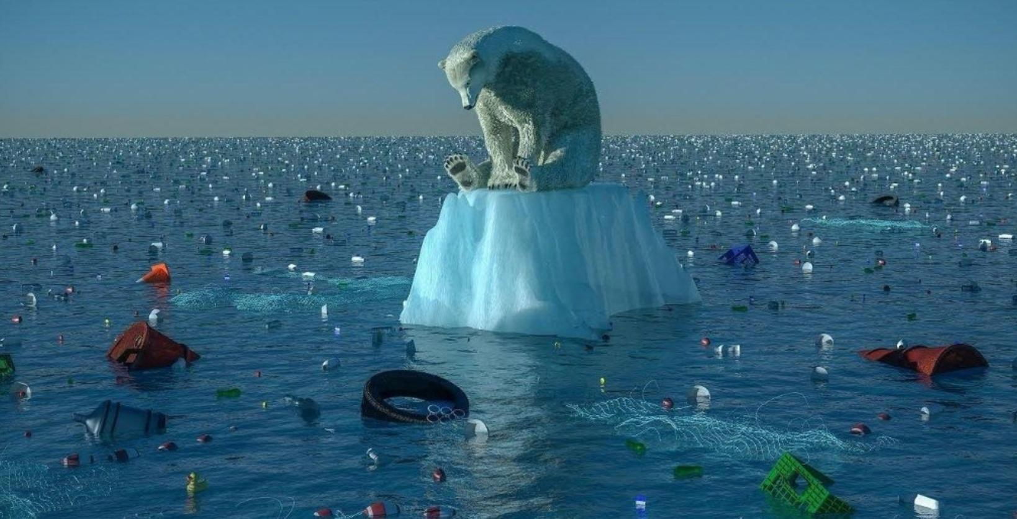
Background and Motivation
Climate change is accelerating, bringing World `Dangerously close` to Irreversible Change.
More devastating fires in California
Persistent drought in the Southwest.
Record flooding in Europe and Africa.
A heat wave, of all things, in Greenland.

Slide 3
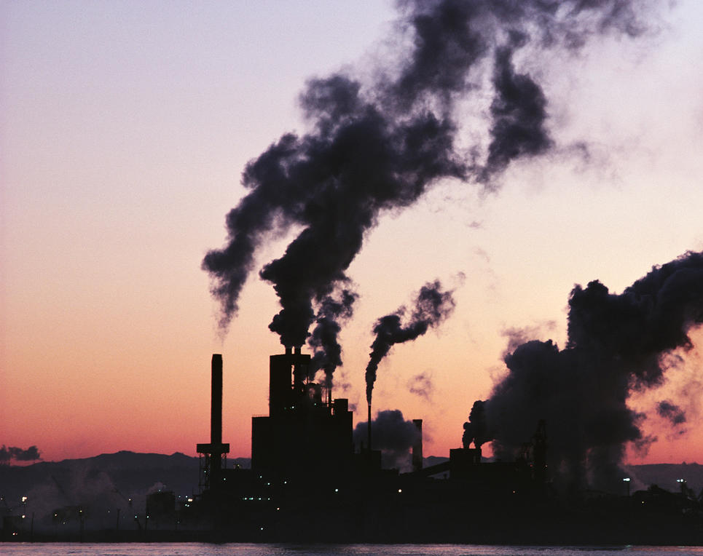
Causes:
First Major Cause:
The burning of fossil fuels like coal, oil, and gas for electricity, heat, and transportation
Second Major Cause:
deforestation, fires, and other forms of forest degradation which contribute up to 20 percent of global carbon emissions.

Slide 4
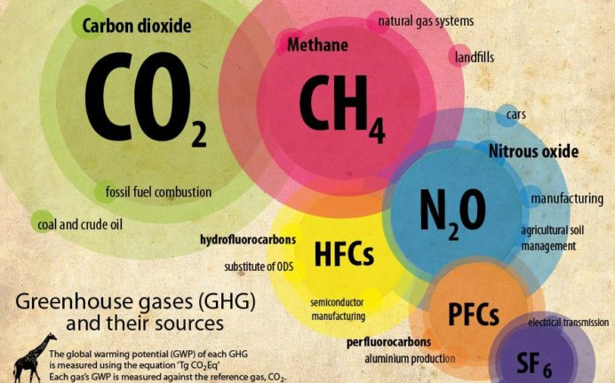
Causes
Greenhouse gases
An increase in the atmospheric concentrations of greenhouse gases produces a warming effect.

Slide 5
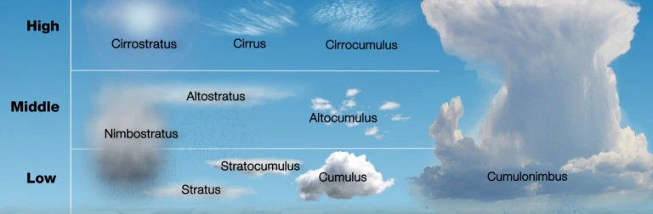
Causes
Cloud Cover
Clouds both reflect sunlight, which cools the Earth, and trap heat in the same way as greenhouse gases, thus warming the Earth.

Slide 6

Causes
Relative Humidity
If the water vapor content stays the same and the temperature drops, the relative humidity increases.
If the water vapor content stays the same and the temperature rises, the relative humidity decreases.
As the climate continues to warm, the prospect of increasingly humid heat waves will increase.

Slide 7
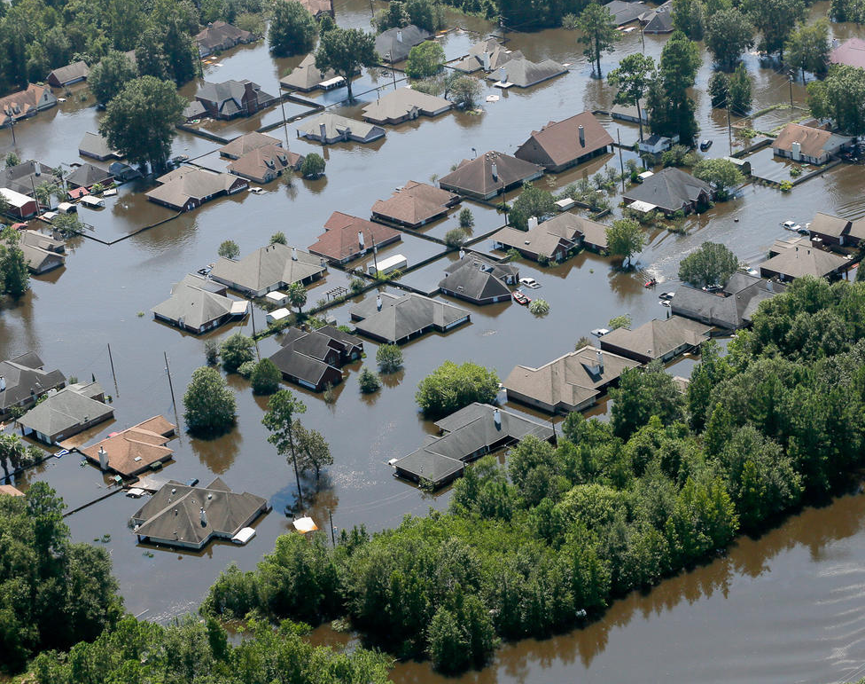
Effects
Extreme Weather
As the earth’s atmosphere heats up, it collects, retains, and drops more water, changing weather patterns and making wet areas wetter and dry areas drier.
Higher temperatures worsen and increase the frequency of many types of disasters, including storms, floods, heat waves, and droughts.

Slide 8
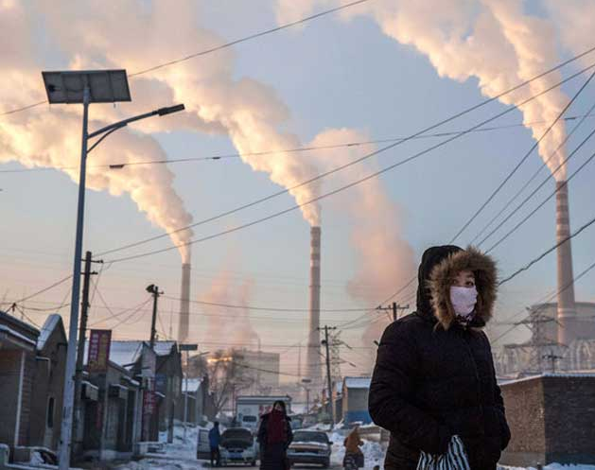
Effects
Dirty air
When the earth’s temperatures rise, not only does our air gets dirtier—with smog and soot levels going up—but there are also more allergenic air pollutants such as circulating mold and pollen

Slide 9
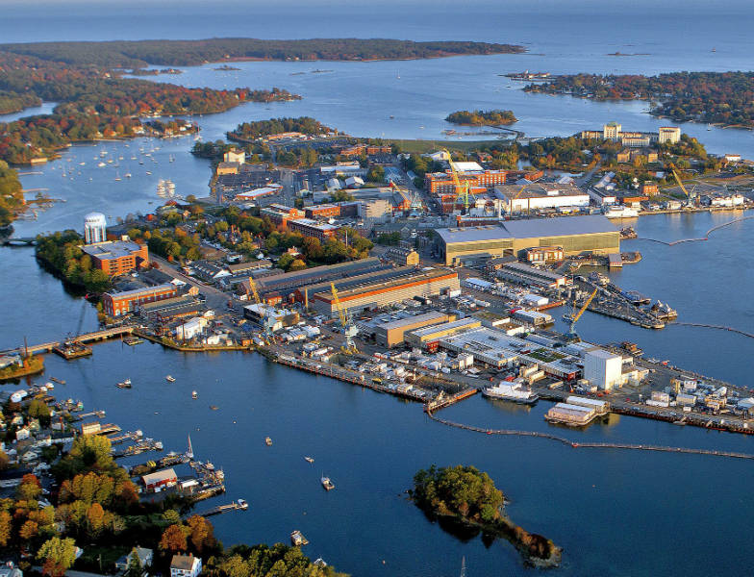
Effects:
Rising seas
The Arctic is heating twice as fast as any other place on the planet.
Island nations face particular risk, as do some of the world’s largest cities, including New York, Miami, Mumbai, and Sydney.

Slide 10
We will be working on these features throughout our project..
Temperature
Precipitation
Wind Speed
Cloud Cover
Relative Humidity
Coal as direct Energy
Oil as direct Energy
Gas as direct Energy
Sea level
CO2 Concentrations
Methane Concentrations
Nitrous Oxide Concentrations
HFCs, PFCs, and SF6 concentrations
Drought severity
Notes:
-> So In order to better understand climate change, We’ve decided to work on these features , these include all the causes of temperature change discussed until now.
-> We based our work mainly on the variation of each feature yearly and also wanted to see how combination of other features explain the variation on a Individual feature

Slide 11
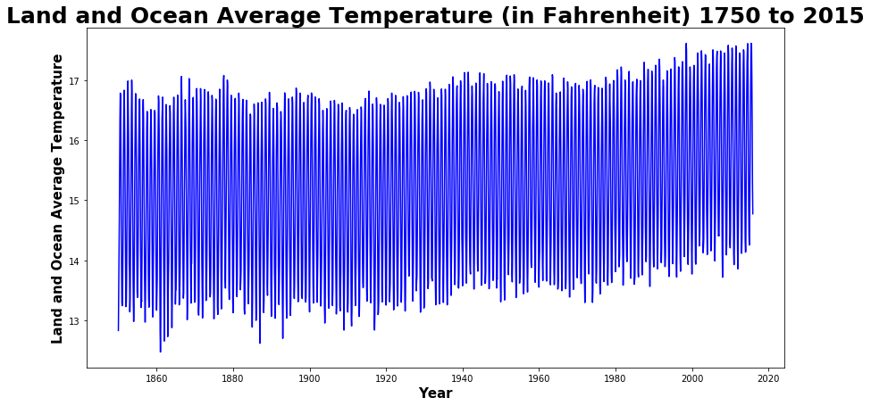
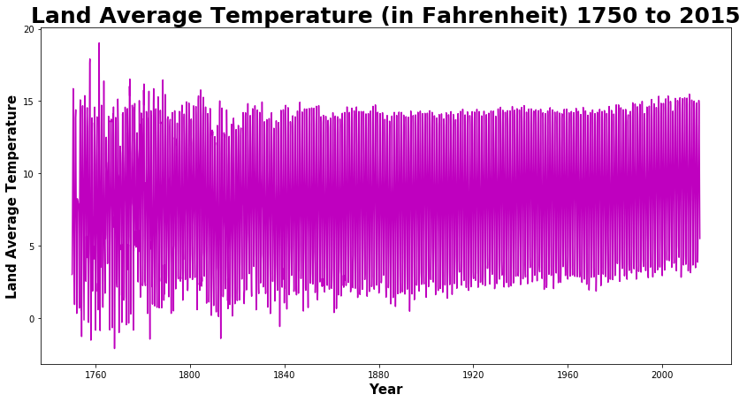
World Average
Notes:
-> This top graph is about Land and ocean average Temperature, It shows the daily average temp from 1750-2015, even through the average temperature is increasing , we could see that it is minimal due to the fact that temperature around the globe evens out and we cannot the variation clearly

Slide 12
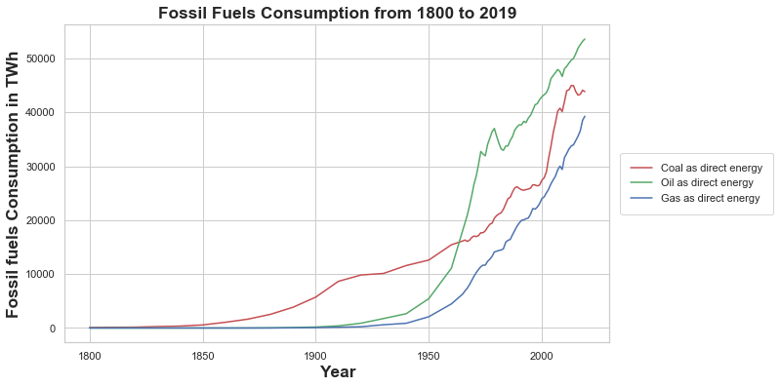
Global Consumption of Fossil fuels

Slide 13
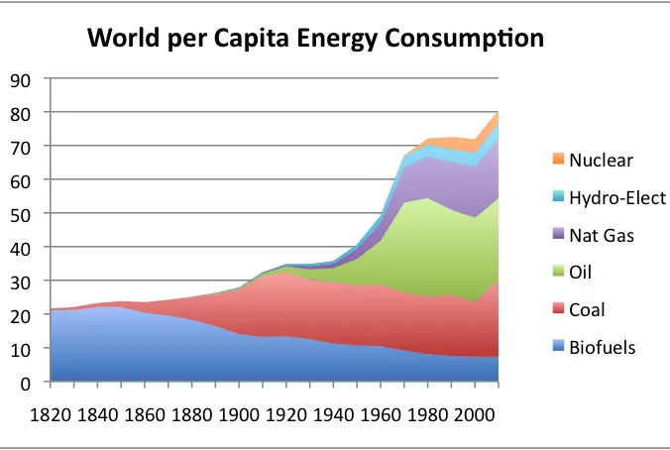
Energy consumption

Slide 14
Our Approach
To show the effects and future outcomes we do not want to just use global average data which would even out the differences across different parts of globe as it would represent the effects generally.
We want to take a more specific approach, by working on 4 politically major countries from different parts of the world. From here on we will be working on these countries:
United States of America
Russia
Australia
United Kingdom (Britain)
Notes:
-> I

Slide 15
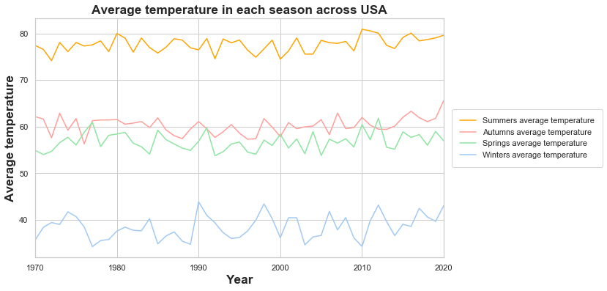
USA

Slide 16
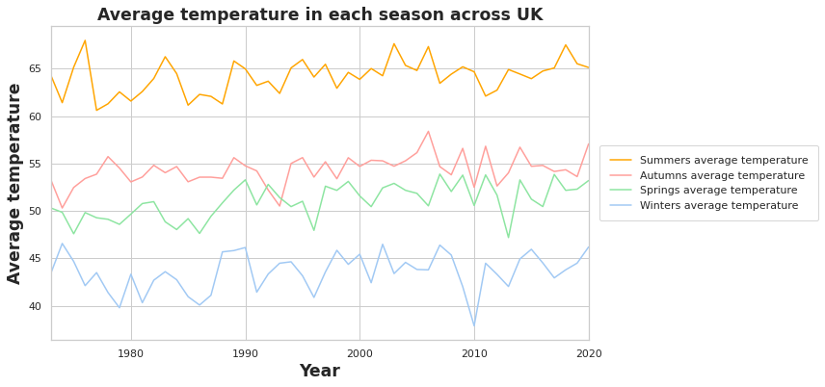
UK

Slide 17
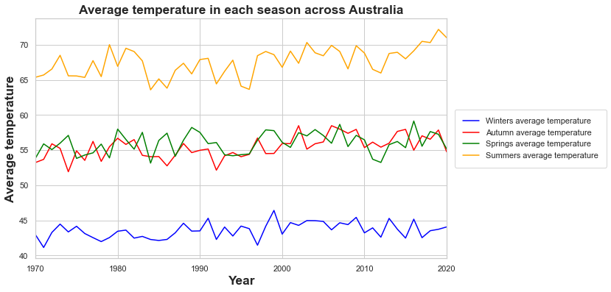
Australia

Slide 18
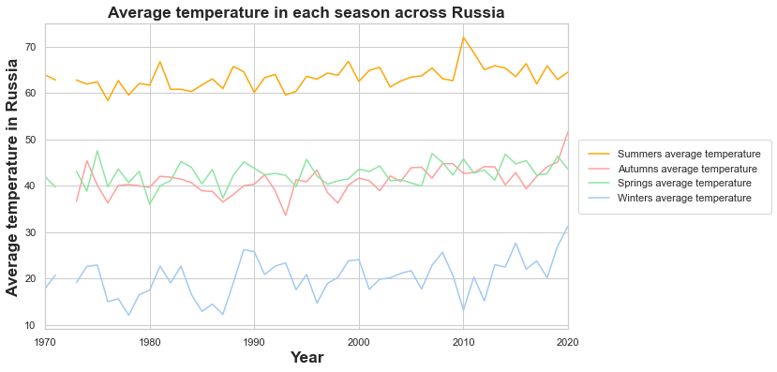
Russia

Slide 19
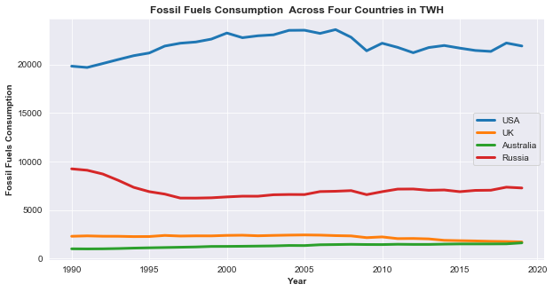
Fossil Fuel Consumption across Four countries

Slide 20
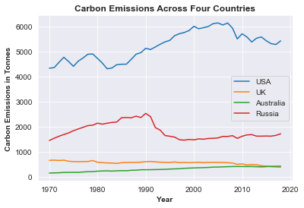
Carbon Emissions

Slide 21
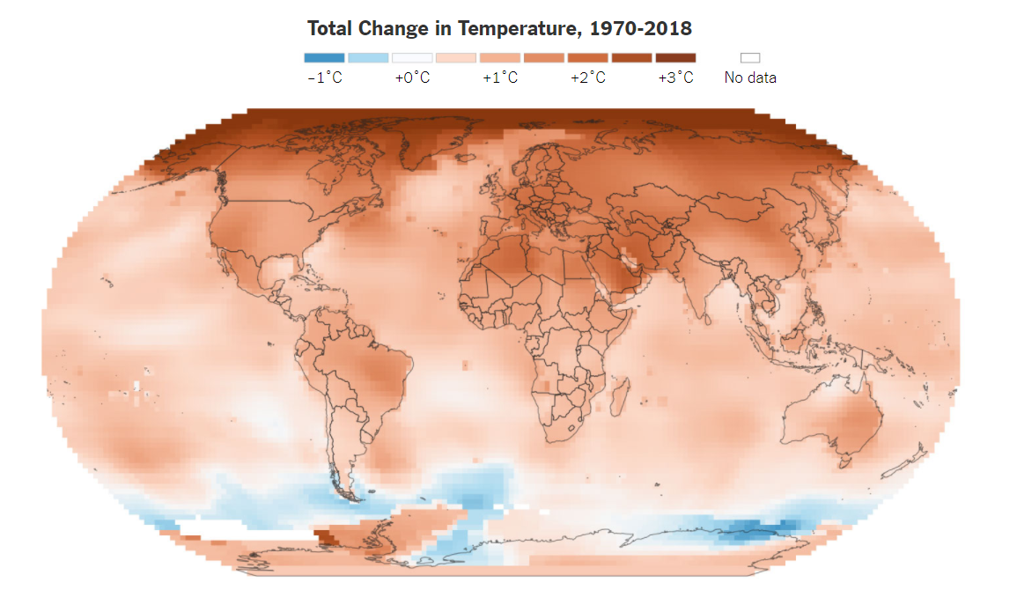
Temperature change

Slide 22
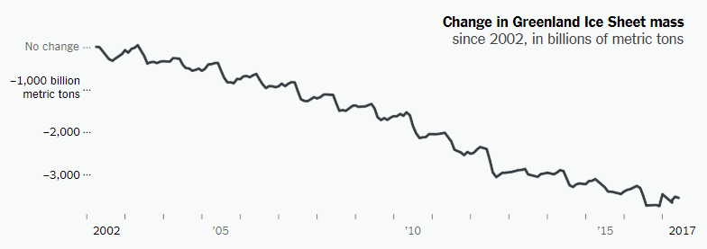
GreenLand Ice sheet Mass

Slide 23
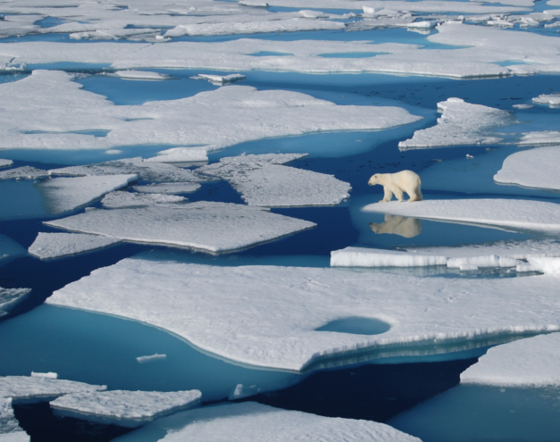
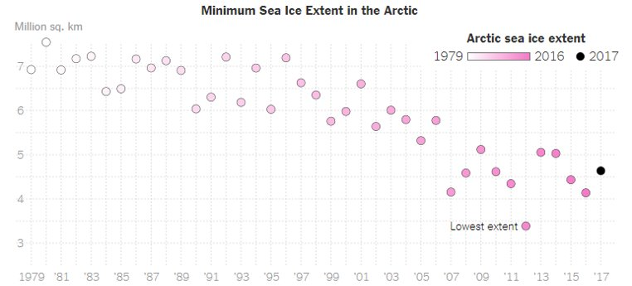
Melting Ice

Slide 24
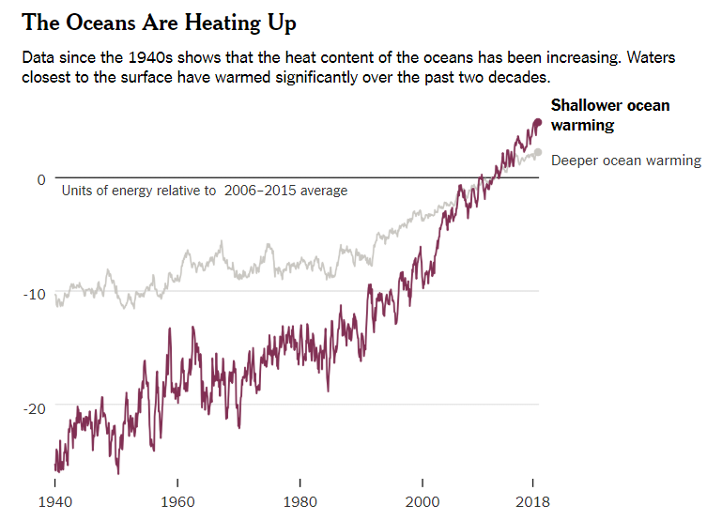
Shallower ocean warming describes depths between 0 and 700 meters. Deeper ocean warming is between 700 and 2,000 meters.

Slide 25
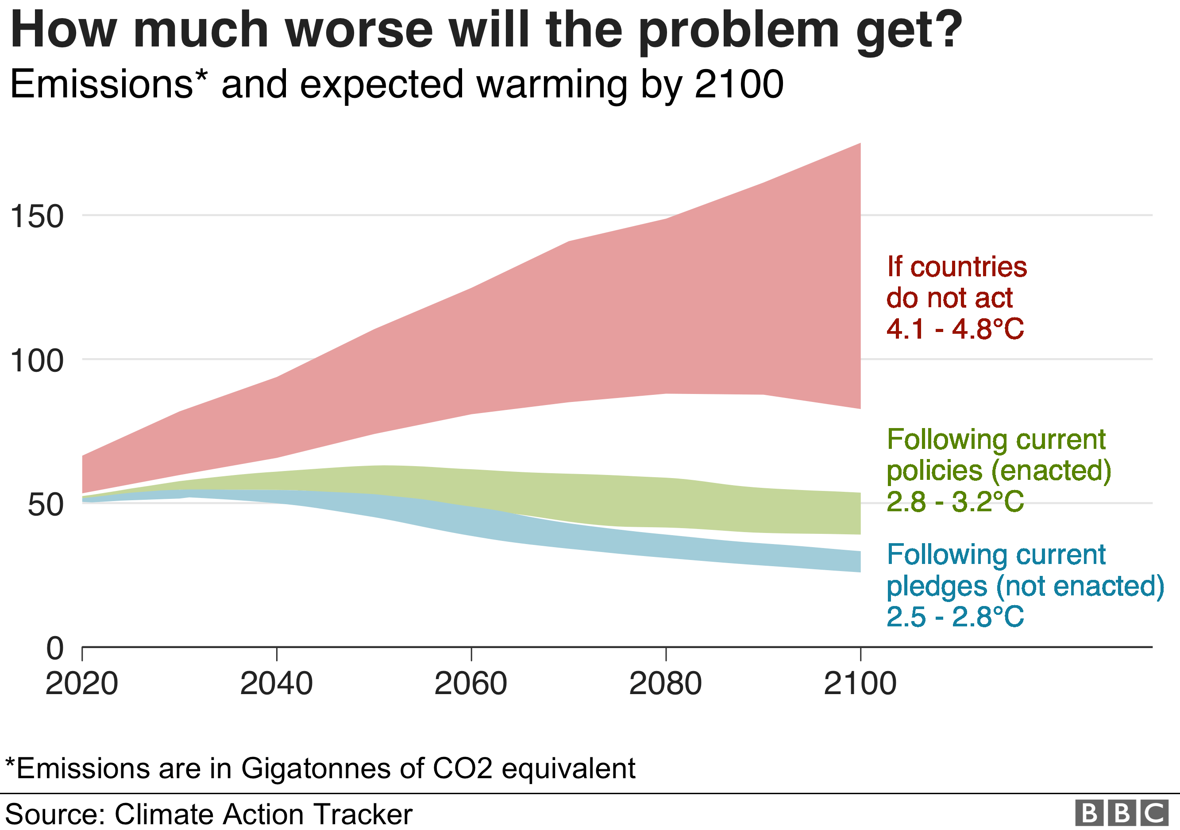
Predictions

Slide 26

Regression

Slide 27

Goal
Predicting
Comparing
Comparing various models for Prediction
Predicting daily Temperature based on different Features for Four Major Countries.

Slide 28
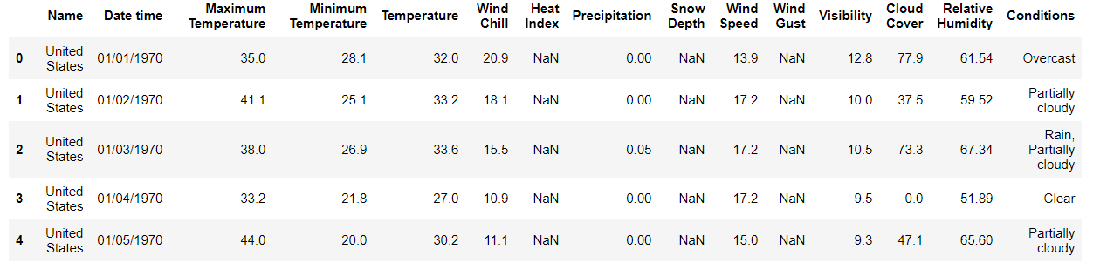
Data in Consideration

Slide 29
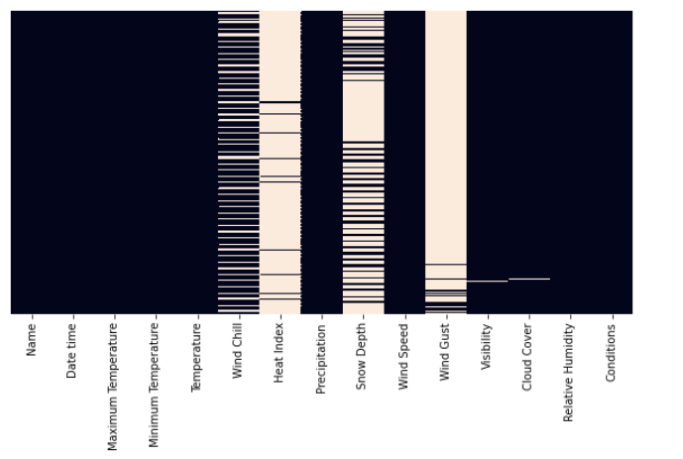
Dropping NA Columns

Slide 30
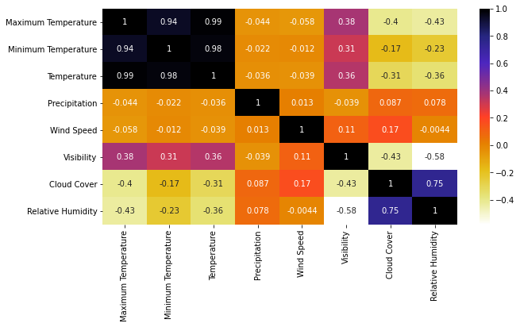
Feature Selection using Correlation - Russia

Slide 31
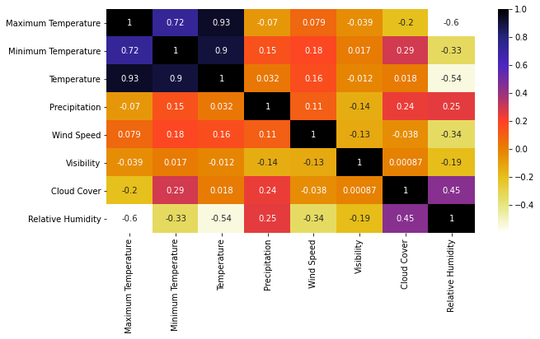
Feature Selection - Australia

Slide 32
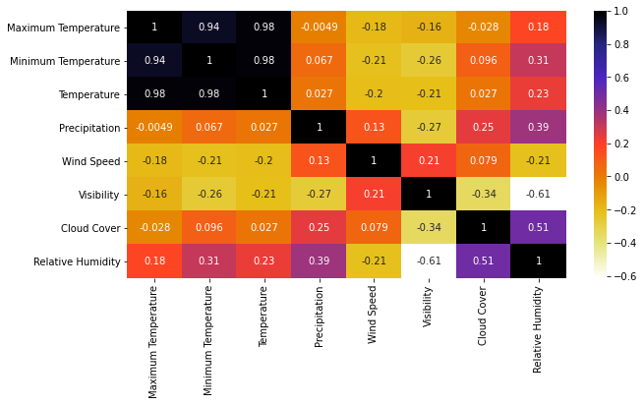
Feature Selection – United States

Slide 33
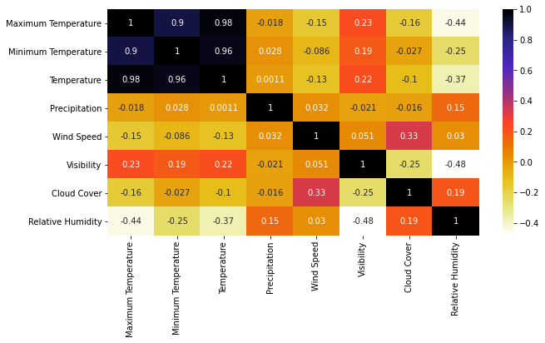
Feature Selection – United Kingdom

Slide 34
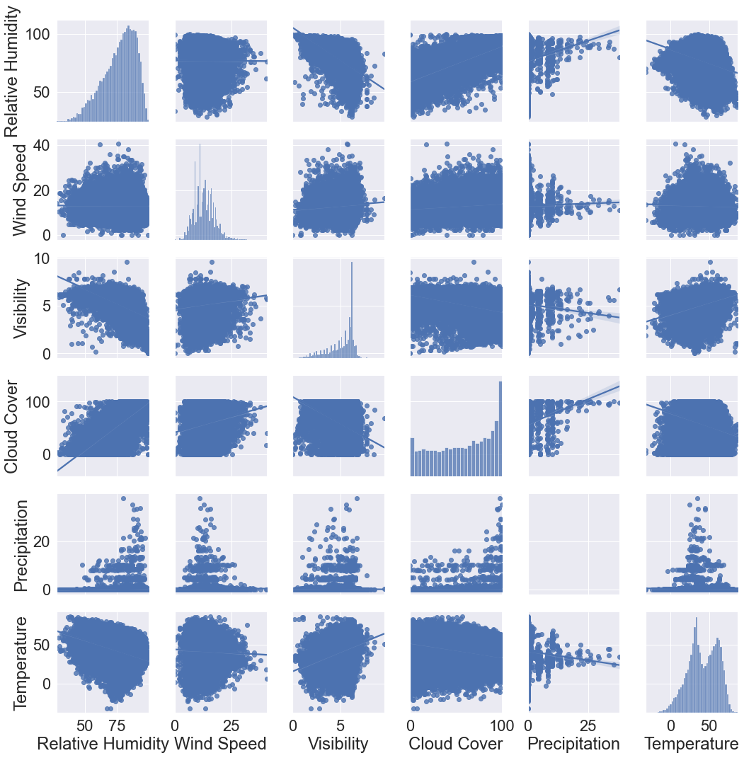
Feature Analysis

Slide 35
Pre-Processing
MinMaxScaler
WindSpeed, Relative Humidity, Visibility and Cloud Cover are in different Scales and have different Measurements. Hence MinMaxScaler was used to transform all features into the range [0,1]
Used for Non-Tree Models such as Support Vector Regressor.

Slide 36
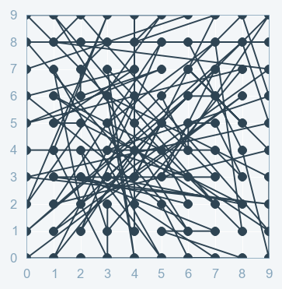
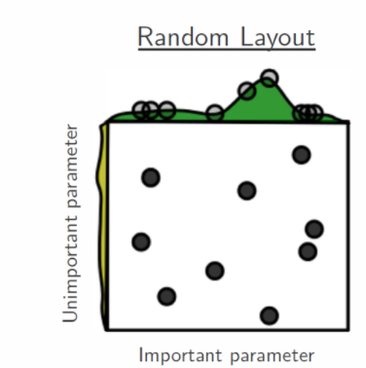
Parameter Tuning - RandmoizedSearchCV
Used for Models like K-Nearest Neighbours, Decision Tree and Support Vector Regressors for selecting best set of parameters.
Why RandomizedSearchCV is Used
Sets up a grid of hyperparameter values and selects random combinations to train the model and score
Allows us to explicitly control number of parameters that are attempted.
Less costly to execute both in terms of computing power and time.
Picks best result often

Slide 37
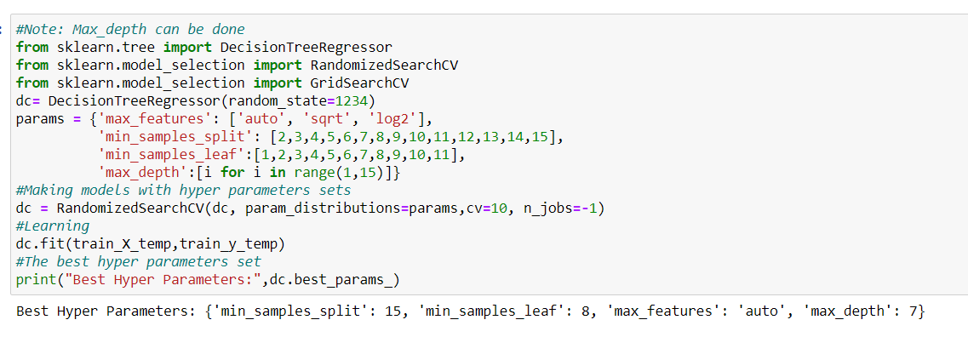
RandomizedSearchCV
Example

Slide 38

Evaluation Metrics
Root Mean Square Error(RMSE) – Difference between Train and Test Set
R2 Square – Test Set

Slide 39
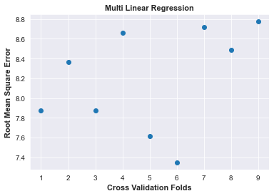
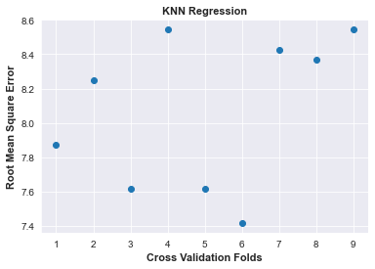
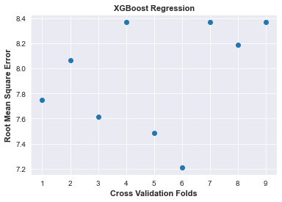
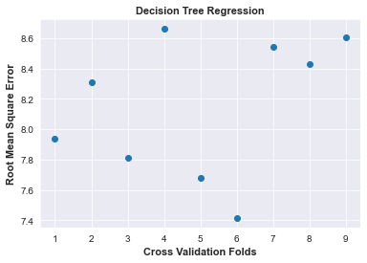
Cross Validation on Train

Slide 40
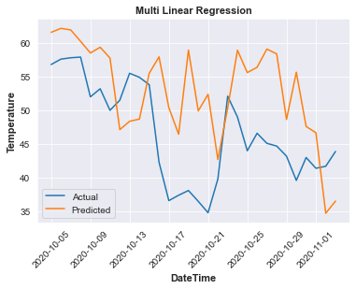
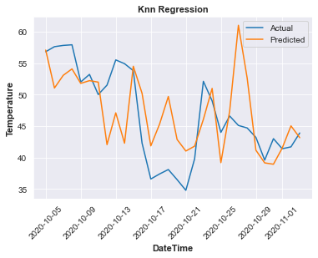
Actual vs Predicted

Slide 41
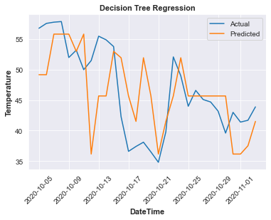
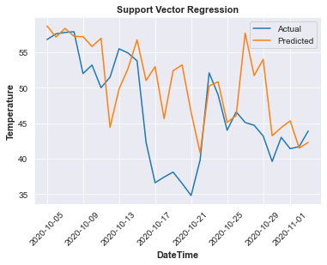
Actual vs Predicted Continued..

Slide 42
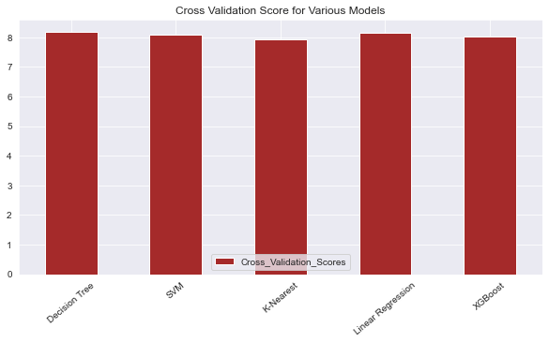
Cross Validation Score Mean

Slide 43
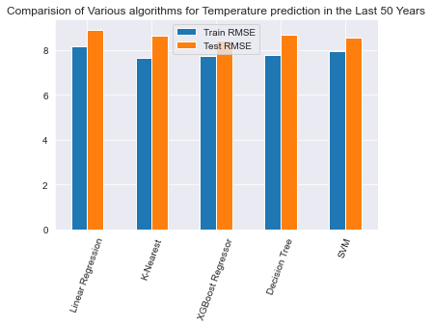
Comparision of Models -

Slide 44
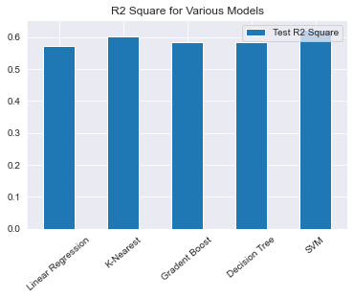
Comparision of Models Contd..

Slide 45
Classification

Slide 46
Goal
Classification of Temperature and Conditions on four major countries.
Comparison of classification models to get the best fit model.

Slide 47
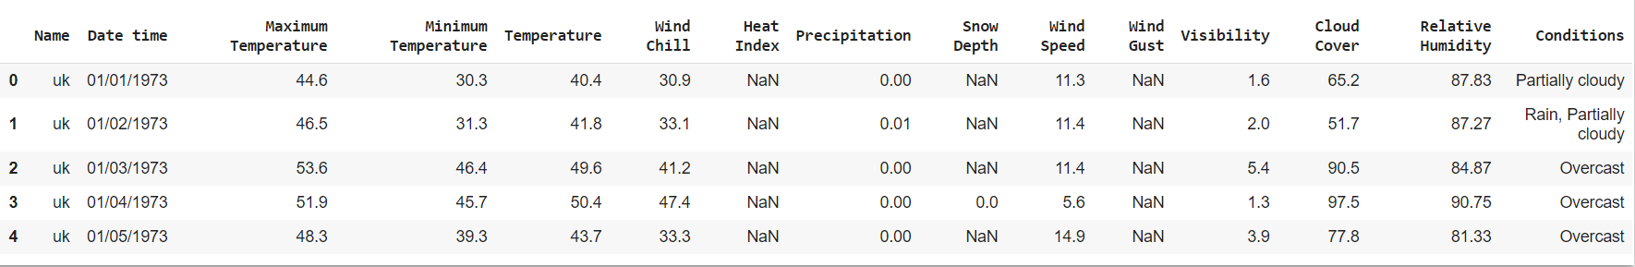
Data

Slide 48
Classes/Categories for Temperature
As temperature falls into running value, we used binning to divide the temperatures.
Temperature is classified into three bins.
Low
Medium
High
#low = (19.936, 41.5]
#medium = (41.5, 63.0]
#high = (63.0, 84.5]
pd.cut(df['Temperature'], 3).head()
For UK, the above mentioned are the ranges of the temperature classes.

Slide 49
Classes/Categories for Conditions
We need to classify 5 conditions based on the features we select for classification. Following are the condition classes.
Partially Cloudy
Rain
Overcast
Snow
Clear

Slide 50
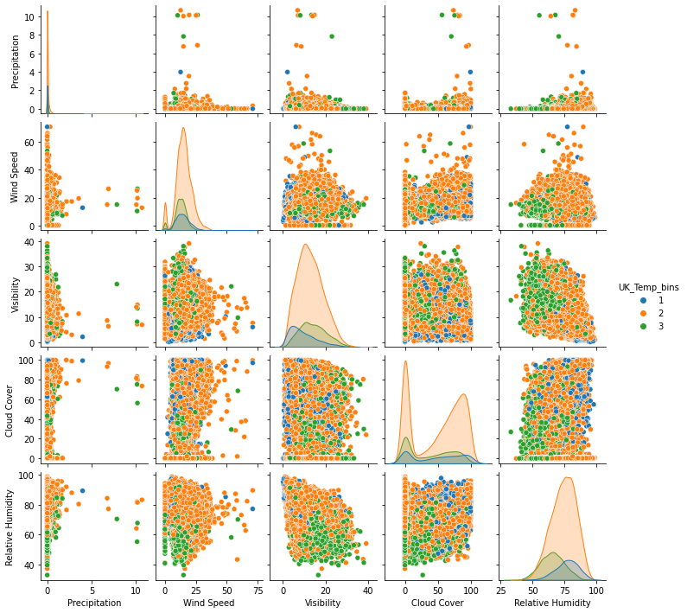
Pair Plots Temperature
Using pair plot we can find the relationships between each single variable.
Here, if we observe we don’t find any change in precipitation when compared relatively with Temperature bins.
So, finally we have some relationship whether it can be negative or positive with all others except for precipitation.
Dropping the Precipitation column for classifying temperature.

Slide 51
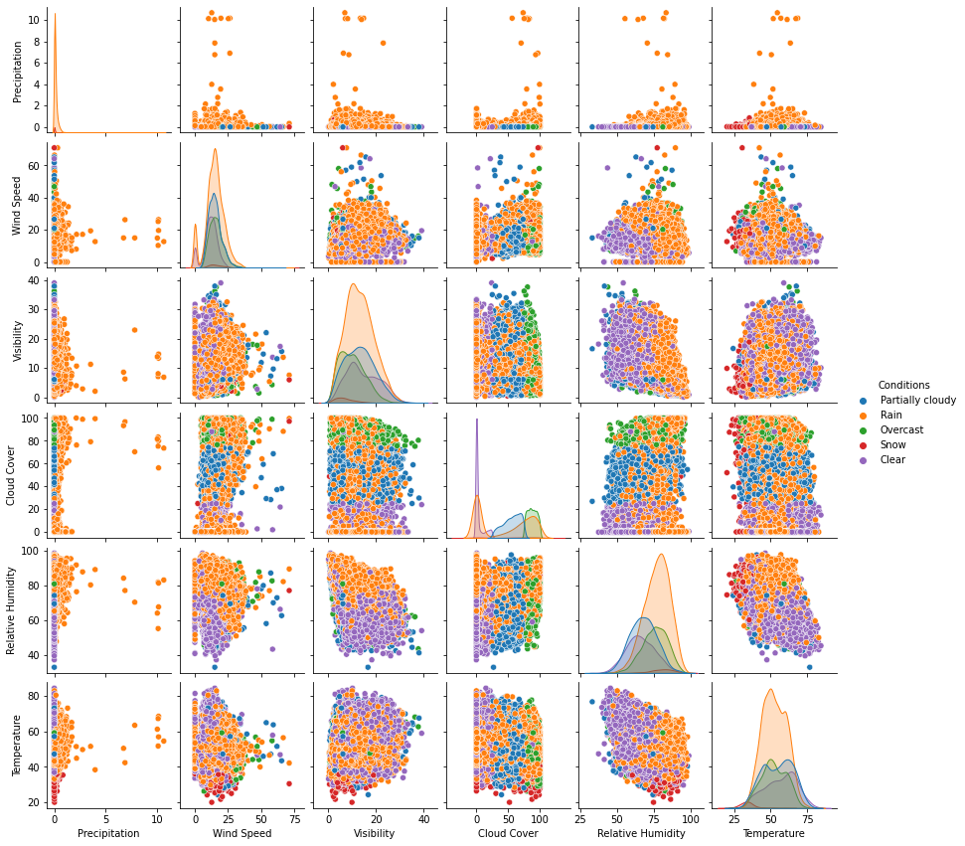
Pair Plots Conditions
Features with more null values are initially dropped from the dataset.
Features considered for pair plots are with zero null values.
If we observe, we could see slight variation for precipitation in this plots and we assume precipitation will have impact on the conditions.
Finally considered features are: Temperature, Relative Humidity, Cloud cover, Visibility, Wind Speed and Precipitation.

Slide 52
Features considered
Temperature
Wind Speed
Visibility
Cloud Cover
Relative Humidity
Conditions
Temperature
Precipitation
Visibility
Cloud Cover
Relative Humidity
Wind Speed

Slide 53
Classification Models
Models used for temperature and conditions classification
Linear SVM
Decision Tree Classifier
KNN Classifier
Random Forest Classifier
Gaussian NB Classifier

Slide 54
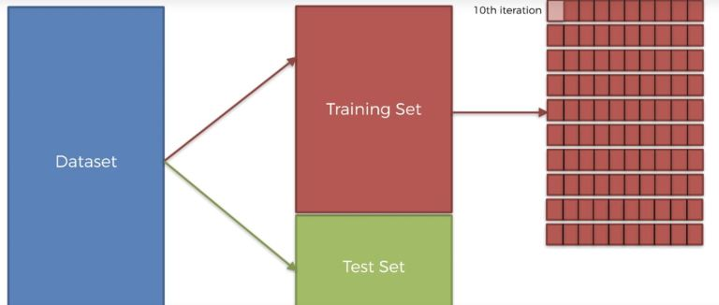
Cross Validation
It will split the training set into 10 folds when K = 10 and we train our model on 9-fold and test it on the last remaining fold.
We can make 10 different combinations of 9-folds to train the model and 1-fold to test it.
Like this, we can train the model and test them all on 10 combinations of training and test sets.

Slide 55
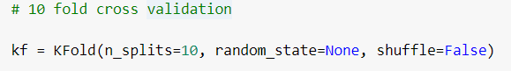
Cross Validation
For Classification, used 10-fold cross validation.
Train and test data is split based on the folds.

Slide 56
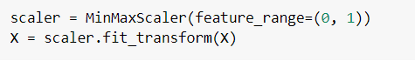
Normalizing and Finding Accuracies
Normalize the train data using Min Max Scaler.
We need to fit the train data into the model we use and find the accuracies.
We have numerous ways to find the accuracies, I used accuracy_score to get the accuracy of each model based on predictions done on test data.

Slide 57

Model Comparisions For Temperature

Slide 58
Models Comparisions
The possible reasons for the models to give best accuracies:
For temperature, Linear SVC performed well for all the four countries, followed by KNN and Gaussian NB Classifier.
The probability of SVC being accurate might be the selected hyperplane is the best fit for the features used.
Dimensions play an important role for KNN classification. The number of neighbors selected results in good accuracies.
NBC is used for Normal distribution data results in good accuracies.

Slide 59

Model comparisions for Conditions

Slide 60
Model Comparisions
The possible reasons for the models to give best accuracies:
For Conditions, Decision Tree and Random Forest Classifier performed well for all the four countries, followed by Gaussian NB Classifier.
The root plays a major role in getting the best accuracies for DT Classifier.
High Dimensional Data can be handled and used to make predictive analysis using RF classifier accurately.
NBC is used for Normal distribution data results in good accuracies.

Slide 61
Anomaly Detection

Slide 62


Global Land Average

Slide 63


Uncertainties in Global Land Average Data

Slide 64


Global Land and Ocean Average Temperature

Slide 65


Coal Consumption as direct energy

Slide 66


Oil consumption as direct energy

Slide 67


Gas consumption as direct energy

Slide 68


Global Population

Slide 69


Rise in the sea level

Slide 70



Annual Average drought conditions in USA

Slide 71




Annual Co2 emissions

Slide 72




Annual Co2 emissions

Slide 73




Daily Temperature

Slide 74




Daily Temperature

Slide 75




Daily Precipitation

Slide 76




Daily Precipitation

Slide 77




Daily Wind speed

Slide 78




Daily Wind speed

Slide 79
Evaluation
As these two models are unsupervised machine learning models there is no standard way for evaluating, but I feel overall Isolation forest model has detected anomalies better than Local Outlier Factor model.
Isolation Forest:
In general the first step to anomaly detection is to construct a profile of what's "normal", and then report anything that cannot be considered normal as anomalous. However, the isolation forest algorithm does not work on this principle; it does not first define "normal" behavior, and it does not calculate point-based distances.

Slide 80

Local Outlier Factor
Local Outlier Factor
Due to the local approach, LOF can identify outliers in a data set that would not be outliers in another area of the data set.
For example, a point at a "small" distance to a very dense cluster is an outlier, while a point within a sparse cluster might exhibit similar distances to its neighbors.
Local outlier factor (LOF) values identify an outlier based on the local neighborhood. Since LOF is a ratio, it is tough to interpret.
The selection of a point as an outlier is user-dependent.

Slide 81
Time series Forecasting

Slide 82
Goal
Predicting
Predicting Monthly Average Temperature, Precipitation, Relative Humidity, Wind Speed, and Visibility for based on the data from last 50 years.
Also, Prediction of Yearly Global Consumption of Coal, Oil and Gas based on last 219 years of data
We have used the ARIMA(Autoregressive Integrated Moving Average ) Time Series Forecasting Model for the same.

Slide 83
P
Pre-processing:
Used Global fuel consumption data which has Yearly consumption of Fuel in TWh.
Used Data frame with data of the features of 4 countries i.e USA, Russia, UK and Australia.
Removed the Irrelevant features, Nan values and inf values from the Data
Got monthly average of all the features for each countries.
Converted Dataframes in to series data
Fit the ARIMA model for predicting the weather.

Slide 84

Arima Model Implementation:

Slide 85


Global Gas Consumption: Predicted vs Actual
RMSE
937.441

Slide 86

Global Coal Consumption: Predicted vs Actual
RMSE
1059.449

Slide 87

Global Oil Consumption: Predicted vs Actual
RMSE
681.871

Slide 88


Temperature: Predicted vs Actual
RMSE
5.455
RMSE
6.584

Slide 89


Temperature: Predicted vs Actual
RMSE
3.625
RMSE
2.595

Slide 90


Wind Speed : Predicted vs Actual
RMSE
1.493
RMSE
1.988

Slide 91


Wind Speed : Predicted vs Actual
RMSE
2.241
RMSE
6.135

Slide 92


Relative Humidity: Predicted vs Actual
RMSE
6.135
RMSE
7.737

Slide 93


Relative Humidity : Predicted vs Actual
RMSE
5.152
RMSE
5.379

Slide 94


Visibility: Predicted vs Actual
RMSE
0.358
RMSE
0.488

Slide 95


Visibility: Predicted vs Actual
RMSE
3.625
RMSE
0.224

Slide 96


Precipitation : Predicted vs Actual
RMSE
0.095
RMSE
0.043

Slide 97


Precipitation : Predicted vs Actual
RMSE
0.050
RMSE
0.051

Slide 98
Predictions for Near Future:

Slide 99
Predictions for Near Future:

Slide 100
Predictions for Near Future:

Slide 101
Conclusion:
Predicted Daily Temperatures of Four Major countries using various regression models from the existing data of last 50 years.
Predicted Temperatures and Conditions using different classification models with Linear SVM and Decision Tree classifiers giving best accuracy, respectively.
Predicted future values of Weather Attributes and Fuel Consumption using ARIMA model for Time series forecasting.

Slide 102
Future Works:
We can work on Ice sheets data to understand how the rise in temperature affecting melting process.
We will extend Classification further by classifying temperature and conditions using the other Classification models to get the best accuracies.
We will extend the Time Series Forecasting based on the correlation of different attributes for Weather and the changes based on the patterns of Geographical locations.

Slide 103

Any Questions?

Slide 104
Thank you

